Slide 1
Higher-order derivatives and power series
ACME General Store
Sales receipt
Item A | $10.7892
Item B | $2.4934
Item C | $3.4435
Total | $16.7261
$$f\left(x\right)=a_{0}+a_{1}\left(x−x_{E}\right)+a_{2}{\left(x−x_{E}\right)}^{2}+a_{3}{\left(x−x_{E}\right)}^{3}+⋯$$

Slide 2
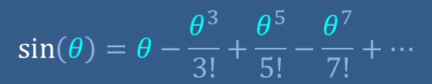
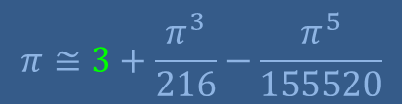


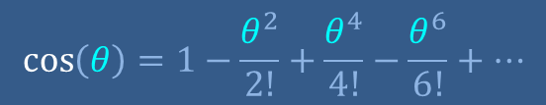
Higher-order derivatives and power series
2nd derivative and curvature
Power series
Power series for sine and cosine
Approximation of π
$$π≅3+\frac{π^{3}}{216}−\frac{π^{5}}{155520}$$
$$\sin\left(θ\right)=θ−\frac{θ^{3}}{3!}+\frac{θ^{5}}{5!}−\frac{θ^{7}}{7!}+⋯$$
1
$$\cos\left(θ\right)=1−\frac{θ^{2}}{2!}+\frac{θ^{4}}{4!}−\frac{θ^{6}}{6!}+⋯$$
1/2
$$\frac{π}{6}$$
$${\sqrt{3}}/2$$

Slide 3







2nd derivative and curvature
$$f\left(x\right)$$
upward slant
downward slant
horizontal
$$x$$
0
$$df/dx$$
positive slope
zero slope
increasing slope
$$x_{0}$$
0
negative slope
$$\frac{d^{2}f}{{dx}^{2}}≔\frac{d\left({df}/{dx}\right)}{dx}$$
$$d^{2}f/{dx}^{2}$$
positive second derivative
$$x$$
0

Slide 4
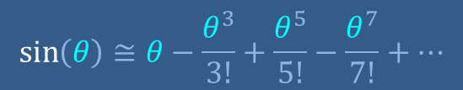
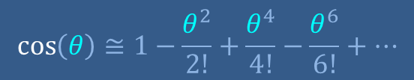
Higher-order derivatives and power series
2nd derivative and curvature
Power series
Power series for sine and cosine
Approximation of π
$$π≅3+\frac{π^{3}}{216}−\frac{π^{5}}{155520}$$
$$\sin\left(θ\right)≅θ−\frac{θ^{3}}{3!}+\frac{θ^{5}}{5!}−\frac{θ^{7}}{7!}+⋯$$
1
$$\cos\left(θ\right)≅1−\frac{θ^{2}}{2!}+\frac{θ^{4}}{4!}−\frac{θ^{6}}{6!}+⋯$$
1/2
$$\frac{π}{6}$$
$${\sqrt{3}}/2$$

Slide 5
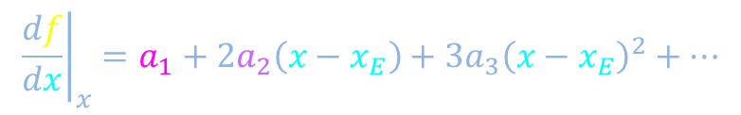
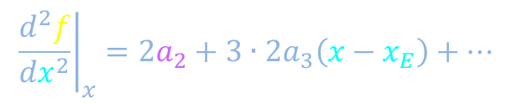



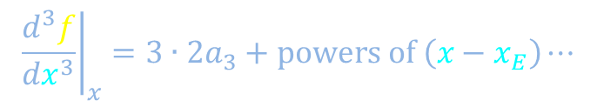
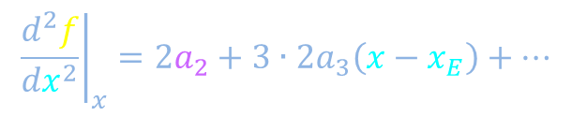










Constructing power series representations
$$≅$$
$$f\left(x\right)=a_{0}+a_{1}\left(x−x_{E}\right)+a_{2}{\left(x−x_{E}\right)}^{2}+a_{3}{\left(x−x_{E}\right)}^{3}+⋯$$
$$f\left(x\right)$$
$$f\left(x_{E}\right)=a_{0}+a_{1}\left(x_{E}−x_{E}\right)+a_{2}{\left(x_{E}−x_{E}\right)}^{2}+⋯$$
$${\left.\frac{df}{dx}\right|}_{x}=a_{1}+2a_{2}\left(x−x_{E}\right)+3a_{3}{\left(x−x_{E}\right)}^{2}+⋯$$
$$x_{E}$$
$$x_{E}$$
$$x_{E}$$
$${\left.\frac{df}{dx}\right|}_{x}=a_{1}+2a_{2}\left(x−x_{E}\right)+3a_{3}{\left(x−x_{E}\right)}^{2}+⋯$$
$${\left.\frac{d^{2}f}{{dx}^{2}}\right|}_{x}=2a_{2}+3∙2a_{3}\left(x−x_{E}\right)+⋯$$
$$x_{E}$$
$$x_{E}$$
$${\left.\frac{d^{2}f}{{dx}^{2}}\right|}_{x}=2a_{2}+3∙2a_{3}\left(x−x_{E}\right)+⋯$$
$${\left.\frac{d^{3}f}{{dx}^{3}}\right|}_{x}=3∙2a_{3}+powers of \left(x−x_{E}\right)⋯$$
$$x_{E}$$
$$x$$
$$x_{E}$$
0
$$x_{E}$$
$${\left.\frac{d^{k}f}{{dx}^{k}}\right|}_{x_{E}}=k!a_{k}$$

Slide 6
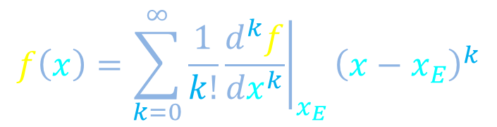
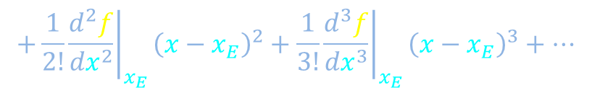
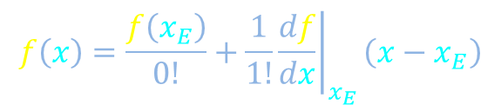

Constructing power series representations
$$f\left(x\right)=a_{0}+a_{1}\left(x−x_{E}\right)+a_{2}{\left(x−x_{E}\right)}^{2}+a_{3}{\left(x−x_{E}\right)}^{3}+⋯$$
$$f\left(x\right)$$
$${\left.\frac{1}{k!}\frac{d^{k}f}{{dx}^{k}}\right|}_{x_{E}}=k!a_{k}$$
$$f\left(x\right)=\frac{f\left(x_{E}\right)}{0!}+\frac{1}{1!}{\left.\frac{df}{dx}\right|}_{x_{E}}\left(x−x_{E}\right)$$
$$+{\frac{1}{2!}{\left.\frac{d^{2}f}{{dx}^{2}}\right|}_{x_{E}}\left(x−x_{E}\right)}^{2}+\frac{1}{3!}{\left.\frac{d^{3}f}{{dx}^{3}}\right|}_{x_{E}}{\left(x−x_{E}\right)}^{3}+⋯$$
Multiply coefficient and powers of binomial
$$f\left(x\right)=\sum_{k=0}^{∞}{\frac{1}{k!}{\left.\frac{d^{k}f}{{dx}^{k}}\right|}_{x_{E}}{\left(x−x_{E}\right)}^{k}}$$
Subtract
Add terms
$$x$$
0
$$x_{E}$$

Slide 7







Construction of accurate power series representation can fail
$$f\left(x\right)=\sum_{k=0}^{∞}{\frac{1}{k!}{\left.\frac{d^{k}f}{{dx}^{k}}\right|}_{x_{E}}{\left(x−x_{E}\right)}^{k}}$$
$$f\left(x\right)$$
$$f\left(x\right)$$
Too jagged
$$x$$
0
$$x_{E}$$
$$f\left(x\right)$$
Too straight
$$x$$
0
$$x_{E}$$
$$x$$
0
$$x_{E}$$

Slide 8
Higher-order derivatives and power series
2nd derivative and curvature
Power series
Power series for sine and cosine
Approximation of π
$$π≅3+\frac{π^{3}}{216}−\frac{π^{5}}{155520}$$
$$\sin\left(θ\right)=θ−\frac{θ^{3}}{3!}+\frac{θ^{5}}{5!}−\frac{θ^{7}}{7!}+⋯$$
1
$$\cos\left(θ\right)=1−\frac{θ^{2}}{2!}+\frac{θ^{4}}{4!}−\frac{θ^{6}}{6!}+⋯$$
1/2
$$\frac{π}{6}$$
$${\sqrt{3}}/2$$

Slide 9






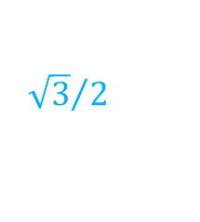



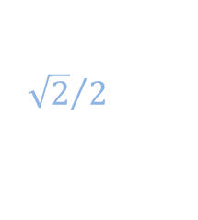








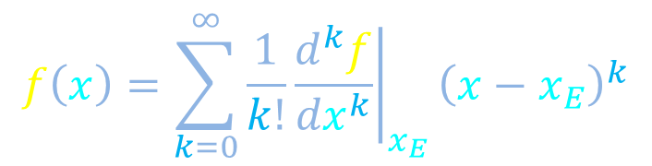
Qualitative expectations for power series for sine
$$f\left(x\right)=\sum_{k=0}^{∞}{\frac{1}{k!}{\left.\frac{d^{k}f}{{dx}^{k}}\right|}_{x_{E}}{\left(x−x_{E}\right)}^{k}}$$
$$f\left(θ\right)=\sin\left(θ\right)$$
Expand around θ_{E} = 0
$$\sin\left(θ\right)≅stuff θ−other stuff farther away$$
1
$${\sqrt{3}}/2$$
$${\sqrt{2}}/2$$
$$1/2$$
$$\sin\left(θ\right)$$
$$θ$$
0
$$\frac{3π}{4}$$
$$\frac{5π}{4}$$
$$\frac{3π}{2}$$
$$\frac{7π}{4}$$
$$\frac{π}{6}$$
$$\frac{π}{4}$$
$$\frac{π}{3}$$
$$\frac{π}{2}$$
$$π$$
$$2π$$
$$−1/2$$
$${−\sqrt{2}}/2$$
$${−\sqrt{3}}/2$$
-1

Slide 10
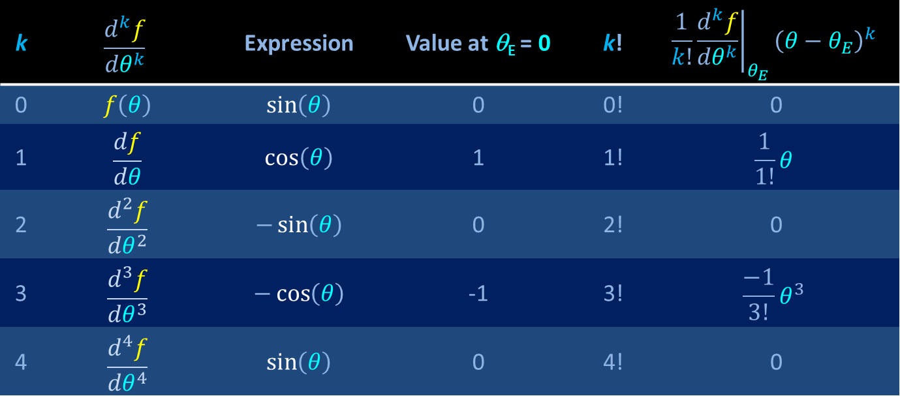
Power series for sine
$$f\left(x\right)=\sum_{k=0}^{∞}{\frac{1}{k!}{\left.\frac{d^{k}f}{{dx}^{k}}\right|}_{x_{E}}{\left(x−x_{E}\right)}^{k}}$$
$$f\left(θ\right)=\sin\left(θ\right)$$
Expand around θ_{E} = 0
k | $$\frac{d^{k}f}{{dθ}^{k}}$$ | Expression | Value at θ_{E} = 0 | k! | $$\frac{1}{k!}{\left.\frac{d^{k}f}{{dθ}^{k}}\right|}_{θ_{E}}{\left(θ−θ_{E}\right)}^{k}$$
0 | $$f\left(θ\right)$$ | $$\sin\left(θ\right)$$ | 0 | 0! | 0
1 | $$\frac{df}{dθ}$$ | $$\cos\left(θ\right)$$ | 1 | 1! | $$\frac{1}{1!}θ$$
2 | $$\frac{d^{2}f}{{dθ}^{2}}$$ | $$−\sin\left(θ\right)$$ | 0 | 2! | 0
3 | $$\frac{d^{3}f}{{dθ}^{3}}$$ | $$−\cos\left(θ\right)$$ | -1 | 3! | $$\frac{−1}{3!}θ^{3}$$
4 | $$\frac{d^{4}f}{{dθ}^{4}}$$ | $$\sin\left(θ\right)$$ | 0 | 4! | 0
1

Slide 11
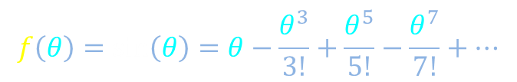
Power series for sine
$$f\left(x\right)=\sum_{k=0}^{∞}{\frac{1}{k!}{\left.\frac{d^{k}f}{{dx}^{k}}\right|}_{x_{E}}{\left(x−x_{E}\right)}^{k}}$$
$$f\left(θ\right)=\sin\left(θ\right)$$
Expand around θ_{E} = 0
k | $$\frac{d^{k}f}{{dθ}^{k}}$$ | Expression | Value at θ_{E} = 0 | k! | $$\frac{1}{k!}{\left.\frac{d^{k}f}{{dθ}^{k}}\right|}_{θ_{E}}{\left(θ−θ_{E}\right)}^{k}$$
0 | $$f\left(θ\right)$$ | $$\sin\left(θ\right)$$ | 0 | 0! | 0
1 | $$\frac{df}{dθ}$$ | $$\cos\left(θ\right)$$ | 1 | 1! | $$\frac{1}{1!}θ$$
2 | $$\frac{d^{2}f}{{dθ}^{2}}$$ | $$−\sin\left(θ\right)$$ | 0 | 2! | 0
3 | $$\frac{d^{3}f}{{dθ}^{3}}$$ | $$−\cos\left(θ\right)$$ | -1 | 3! | $$\frac{−1}{3!}θ^{3}$$
4 | $$\frac{d^{4}f}{{dθ}^{4}}$$ | $$\sin\left(θ\right)$$ | 0 | 4! | 0
$$f\left(θ\right)=\sin\left(θ\right)=θ−\frac{θ^{3}}{3!}+\frac{θ^{5}}{5!}−\frac{θ^{7}}{7!}+⋯$$

Slide 12









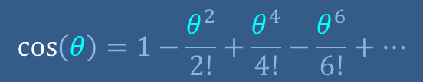









Power series for sine is as expected
$$f\left(θ\right)=\sin\left(θ\right)=θ−\frac{θ^{3}}{3!}+\frac{θ^{5}}{5!}−\frac{θ^{7}}{7!}+⋯$$
1
$${\sqrt{3}}/2$$
$$\sin\left(θ\right)$$
$$\cos\left(θ\right)=1−\frac{θ^{2}}{2!}+\frac{θ^{4}}{4!}−\frac{θ^{6}}{6!}+⋯$$
$$\sin\left(θ\right)≅stuff θ−other stuff farther away$$
$${\sqrt{2}}/2$$
$$1/2$$
$$\cos\left(θ\right)$$
$$θ$$
0
$$\frac{2π}{3}$$
$$\frac{3π}{4}$$
$$\frac{5π}{6}$$
$$\frac{5π}{4}$$
$$\frac{3π}{2}$$
$$\frac{5π}{3}$$
$$\frac{11π}{6}$$
$$\frac{π}{6}$$
$$\frac{π}{4}$$
$$\frac{π}{3}$$
$$\frac{π}{2}$$
$$π$$
$$\frac{7π}{6}$$
$$\frac{4π}{3}$$
$$\frac{7π}{4}$$
$$2π$$
$$−1/2$$
$${−\sqrt{2}}/2$$
$${−\sqrt{3}}/2$$
-1

Slide 13
Higher-order derivatives and power series
2nd derivative and curvature
Power series
Power series for sine and cosine
Approximation of π
$$π≅3+\frac{π^{3}}{216}−\frac{π^{5}}{155520}$$
$$\sin\left(θ\right)=θ−\frac{θ^{3}}{3!}+\frac{θ^{5}}{5!}−\frac{θ^{7}}{7!}+⋯$$
1
$$\cos\left(θ\right)=1−\frac{θ^{2}}{2!}+\frac{θ^{4}}{4!}−\frac{θ^{6}}{6!}+⋯$$
1/2
$$\frac{π}{6}$$
$${\sqrt{3}}/2$$

Slide 14
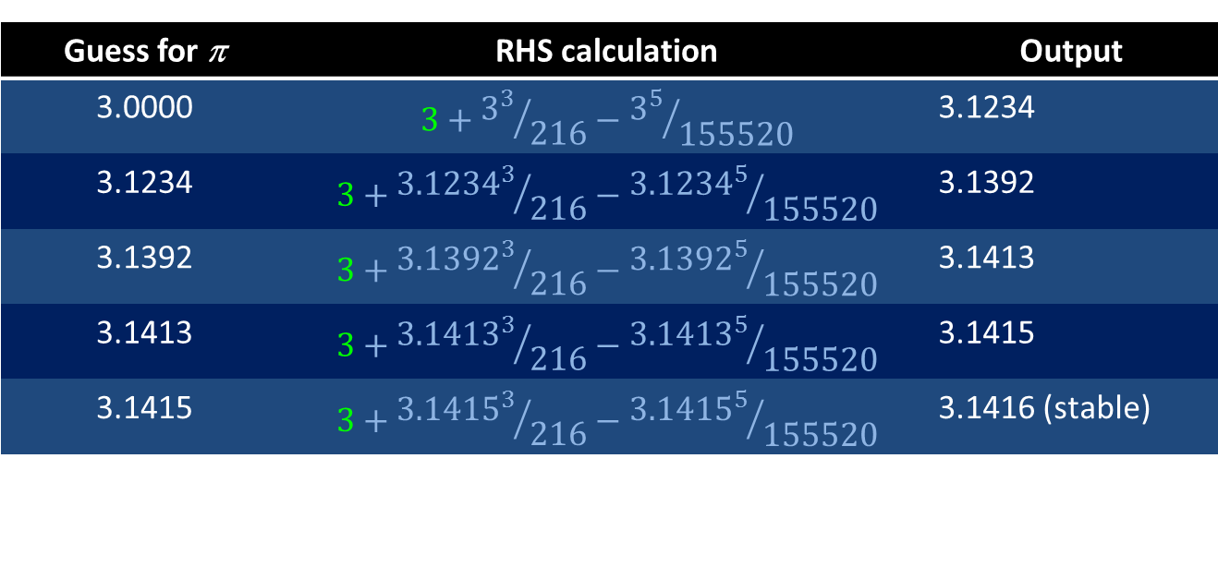

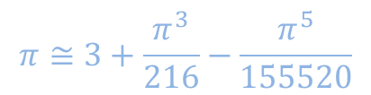
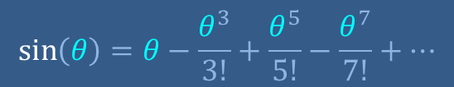
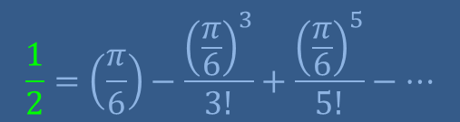
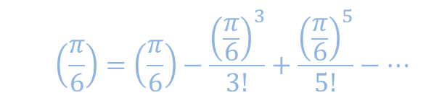

Using a power series and iteration to approximate π
$$\sin\left(θ\right)=θ−\frac{θ^{3}}{3!}+\frac{θ^{5}}{5!}−\frac{θ^{7}}{7!}+⋯$$
$$\sin\left(\frac{π}{6}\right)=\left(\frac{π}{6}\right)−\frac{{\left(\frac{π}{6}\right)}^{3}}{3!}+\frac{{\left(\frac{π}{6}\right)}^{5}}{5!}−⋯$$
1
$$\frac{1}{2}=\left(\frac{π}{6}\right)−\frac{{\left(\frac{π}{6}\right)}^{3}}{3!}+\frac{{\left(\frac{π}{6}\right)}^{5}}{5!}−⋯$$
1/2
$$\frac{π}{6}$$
$${\sqrt{3}}/2$$
$$π≅3+\frac{π^{3}}{216}−\frac{π^{5}}{155520}$$
Guess for π | RHS calculation | Output
3.0000 | $$3+{3^{3}}/{216}−{3^{5}}/{155520}$$ | 3.1234
3.1234 | $$3+{{3.1234}^{3}}/{216}−{{3.1234}^{5}}/{155520}$$ | 3.1392
3.1392 | $$3+{{3.1392}^{3}}/{216}−{{3.1392}^{5}}/{155520}$$ | 3.1413
3.1413 | $$3+{{3.1413}^{3}}/{216}−{{3.1413}^{5}}/{155520}$$ | 3.1415
3.1415 | $$3+{{3.1415}^{3}}/{216}−{{3.1415}^{5}}/{155520}$$ | 3.1416 (stable)

Slide 15
Higher-order derivatives and power series
2nd derivative and curvature
Power series
ACME General Store
Sales receipt
Item A | $10.7892
Item B | $2.4934
Item C | $3.4435
Total | $16.7261
Power series for sine and cosine
Approximation of π
$$π≅3+\frac{π^{3}}{216}−\frac{π^{5}}{155520}$$
$$\sin\left(θ\right)=θ−\frac{θ^{3}}{3!}+\frac{θ^{5}}{5!}−\frac{θ^{7}}{7!}+⋯$$
1
$$\cos\left(θ\right)=1−\frac{θ^{2}}{2!}+\frac{θ^{4}}{4!}−\frac{θ^{6}}{6!}+⋯$$
1/2
$$\frac{π}{6}$$
$${\sqrt{3}}/2$$

